Slide 1
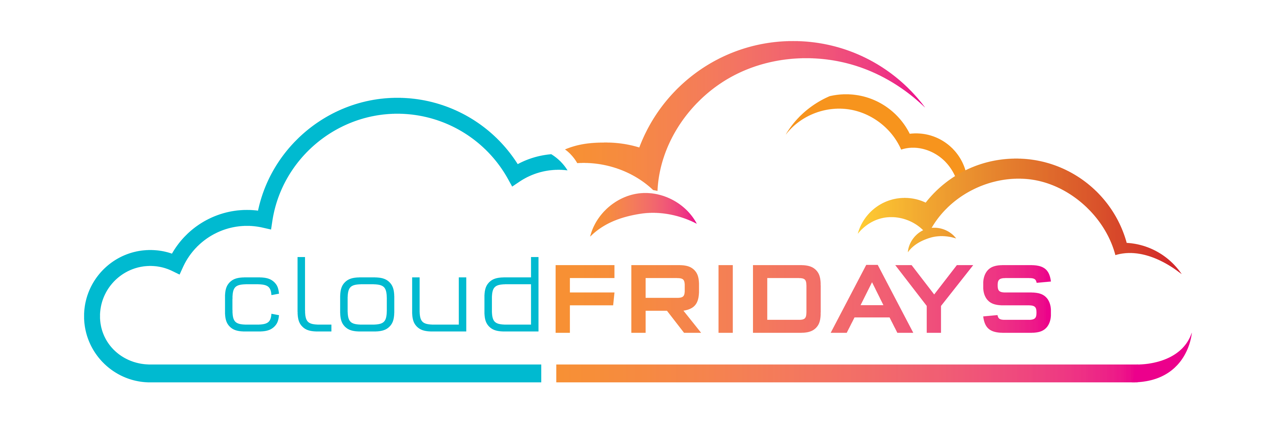

Azure Networking
Vnets, Load Balancer, VPN Gateway, Application Gateway, ExpressRoute
Matthew Levy
Enterprise Mobility MVP
@skrods

Slide 2
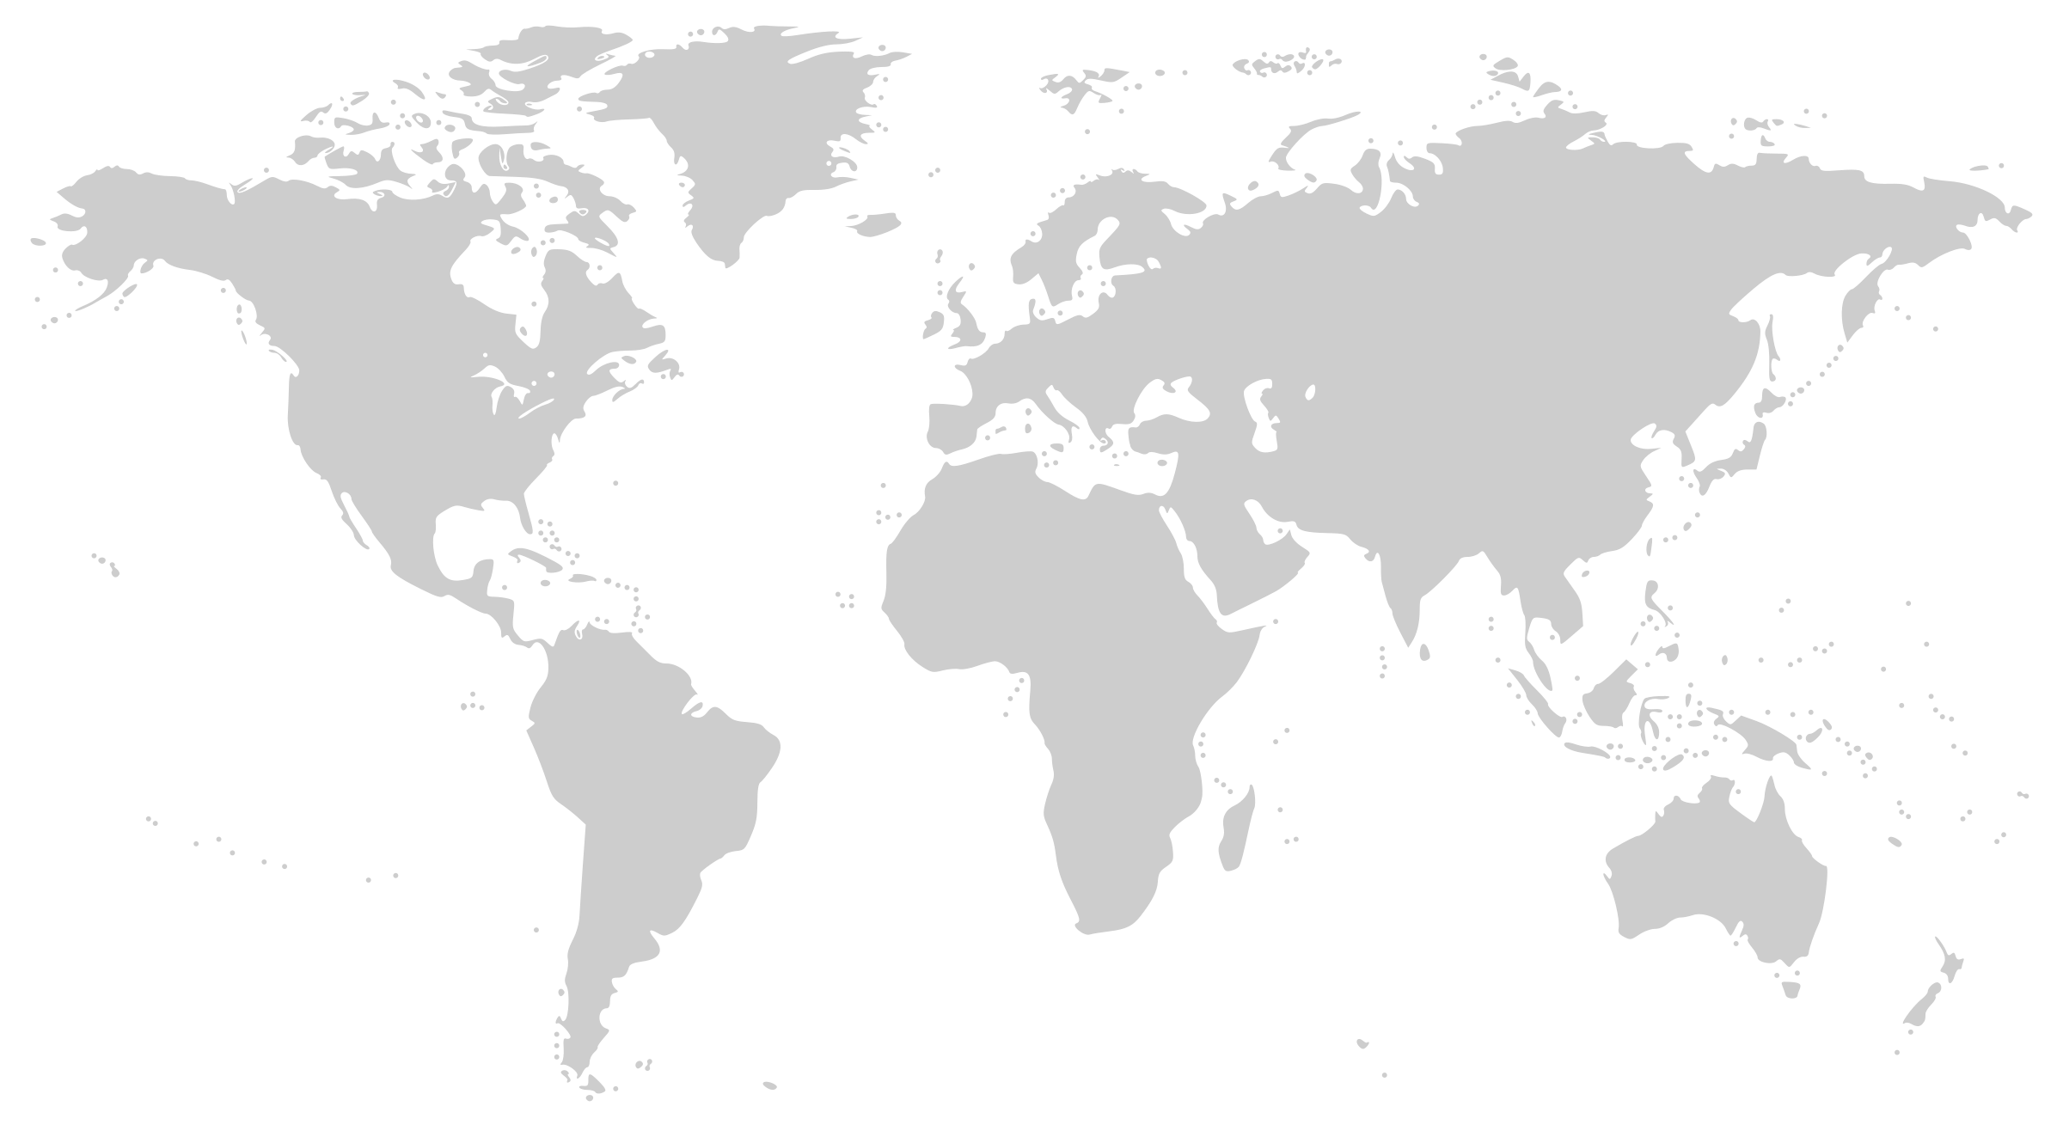
Microsoft Global Network
Greenland
Svalbard
United States
Sweden
Norway
Russia
Canada
United Kingdom
Poland
Ukraine
Kazakistan
France
Russia
United States
Turkey
Algeria
Iran
China
Pacific Ocean
Mexico
Atlanta Ocean
Libya
Egypt
Saudi Arabia
India
Myanmar (Burma)
One of the largest private
networks in the world
8,000+ ISP sessions
130+ edge sites
44 ExpressRoute locations
33,000 miles of lit fiber
SDN Managed (SWAN, OLS)
Mali
Niger
Sudan
Pacific Ocean
Nigeria
Chad
Venezuela
Ethiopia
Colombia
Dr Congo
Peru
Angola
Indonesia
Brazil
Zambia
Indian Ocean
Bolivia
Nambia
South Africa
Australia
Owned Capacity
Data center
Argentina
Leased Capacity
Moving to Owned
Edge Site
DCs and Network sites not exhaustive

Slide 3

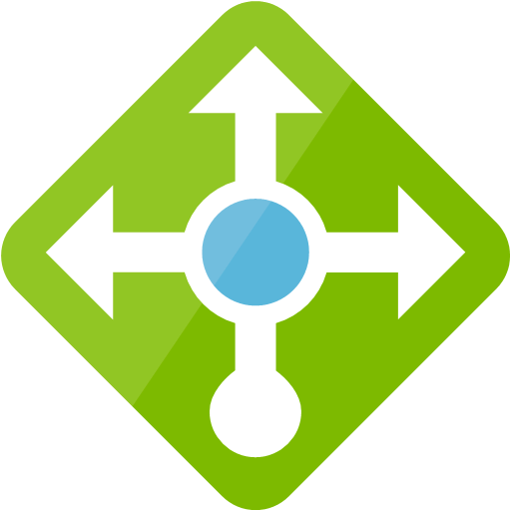


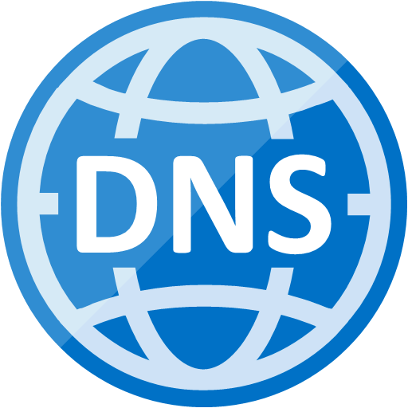


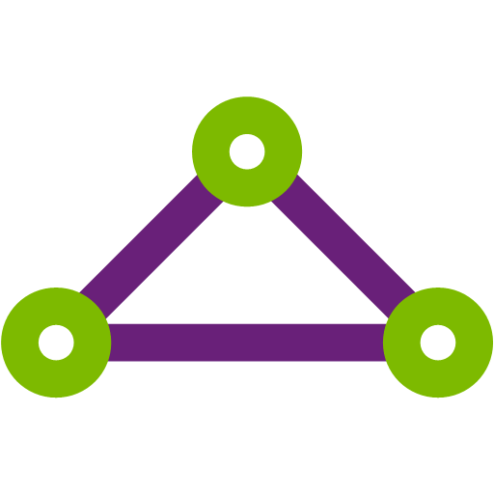

Robust networking infrastructure services
Virtual Network
Provision private networks, optionally connect to on premise datacenters. NSG, User Defined Routes, & IP addresses.
Load Balancer
Deliver high availability and network performance to your applications
Application Gateway/WAF
Build scalable and highly-available web front ends in Azure
DDoS Protection
Protect your Azure resources from DDoS attacks
VPN Gateway
Establish secure, cross-premise connectivity
Azure DNS
Host your DNS domain in Azure
Content Delivery Network
Ensure secure, reliable content delivery with broad global reach
Traffic Manager
Route incoming traffic for high performance and availability
ExpressRoute
Dedicated private network fiber connections to Azure
Network Watcher
Network performance monitoring and diagnostics solution
Notes:
These are all the component pieces of Azure’s networking infrastructure
Azure DDoS Protection Standard is a new offering which provides additional DDoS mitigation capabilities and is automatically tuned to protect your specific Azure resources. Protection is simple to enable on any new or existing Virtual Network and requires no application or resource changes. Standard utilizes dedicated monitoring and machine learning to configure DDoS protection policies tuned to your Virtual Network. This additional protection is achieved by profiling your application’s normal traffic patterns, intelligently detecting malicious traffic and mitigating attacks as soon as they are detected. DDoS Protection Standard provides attack telemetry views through Azure Monitor, enabling alerting when your application is under attack. Integrated Layer 7 application protection can be provided by Application Gateway WAF.

Slide 4

Hyperscale datacentre infrastructure Terminology
Region
Set of datacenters in the same metro area
Number and exact location of DC facilities not exposed to end users
Any two VMs hosted in the same region are less than 2ms away from each other (RTT)
Inter-DC switching bandwidth in a region up to 1.6 Pb/s, depending on the region DC capacity (MW)
Availability zones (only in select regions)
Logical partitioning of DC facilities in a region based on geographical position
Each partition is an availability zone
Any two VMs in the same availability zone are less than 1ms away from each other (RTT)
DC facilities in each zone have independent power, cooling and network
DC facilities in each zone are distant enough from other zones not to be impacted by adverse events (e.g. fires) at the same time
Geography
Set of regions in the same geo-political area
Can be a country, or a continent

Slide 5
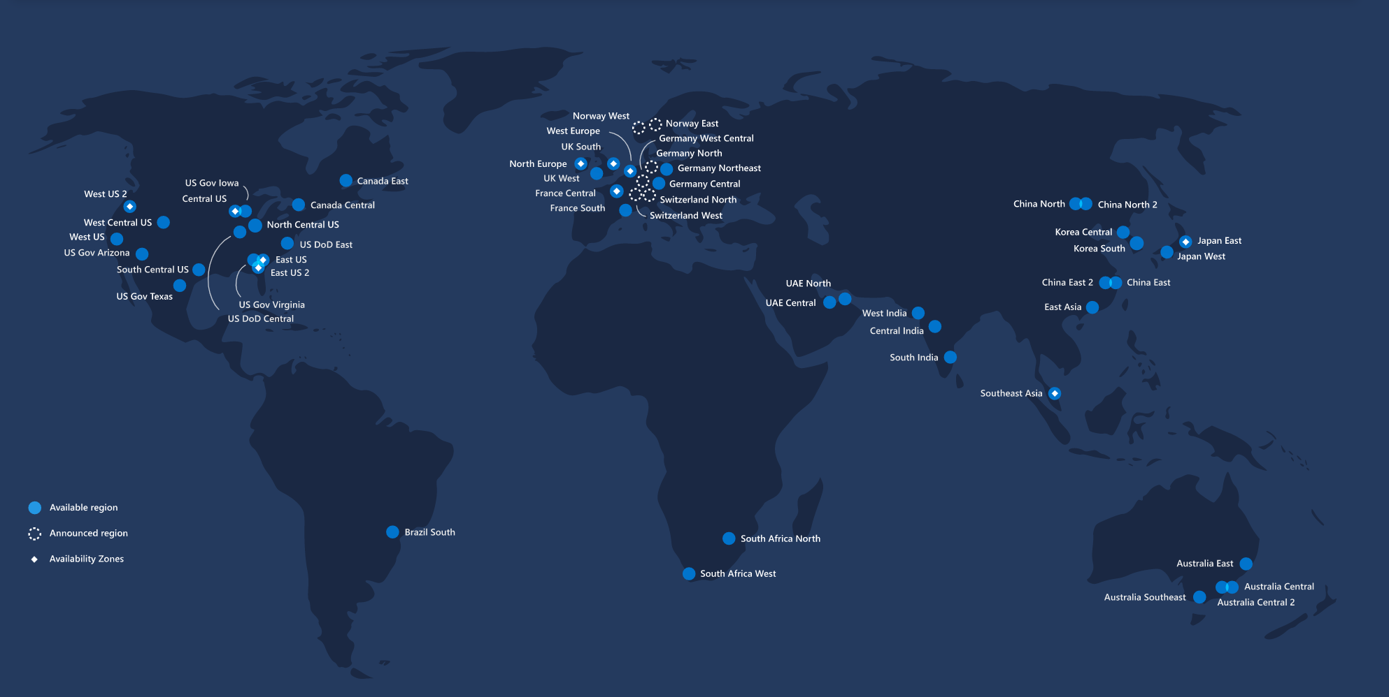
Hyperscale datacentre infrastructure Terminology – RSA example
“South Africa North” is a region
“South Africa West” is a region

Slide 6
Hyperscale datacentre infrastructure Terminology – RSA example
“Africa” is a geography with two regions

Slide 7
Azure networking fundamentals

Slide 8
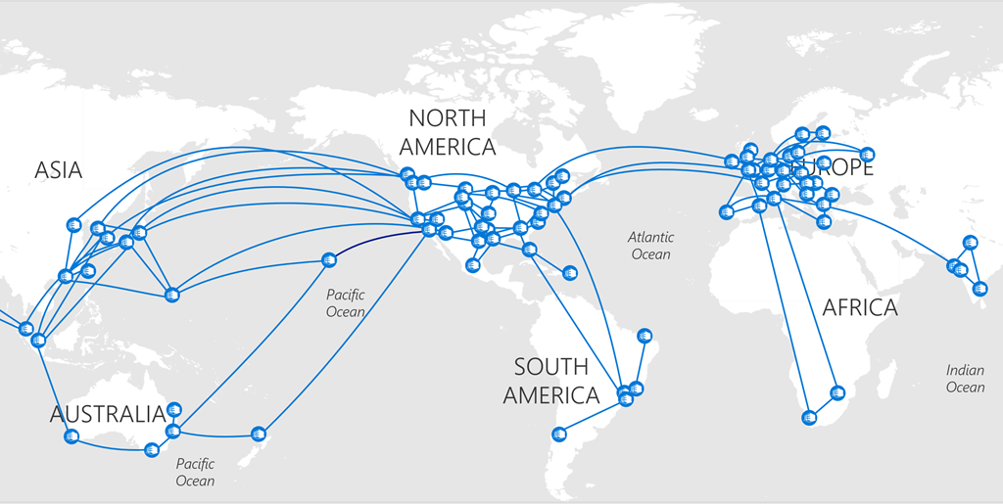
Microsoft global WAN

Slide 9
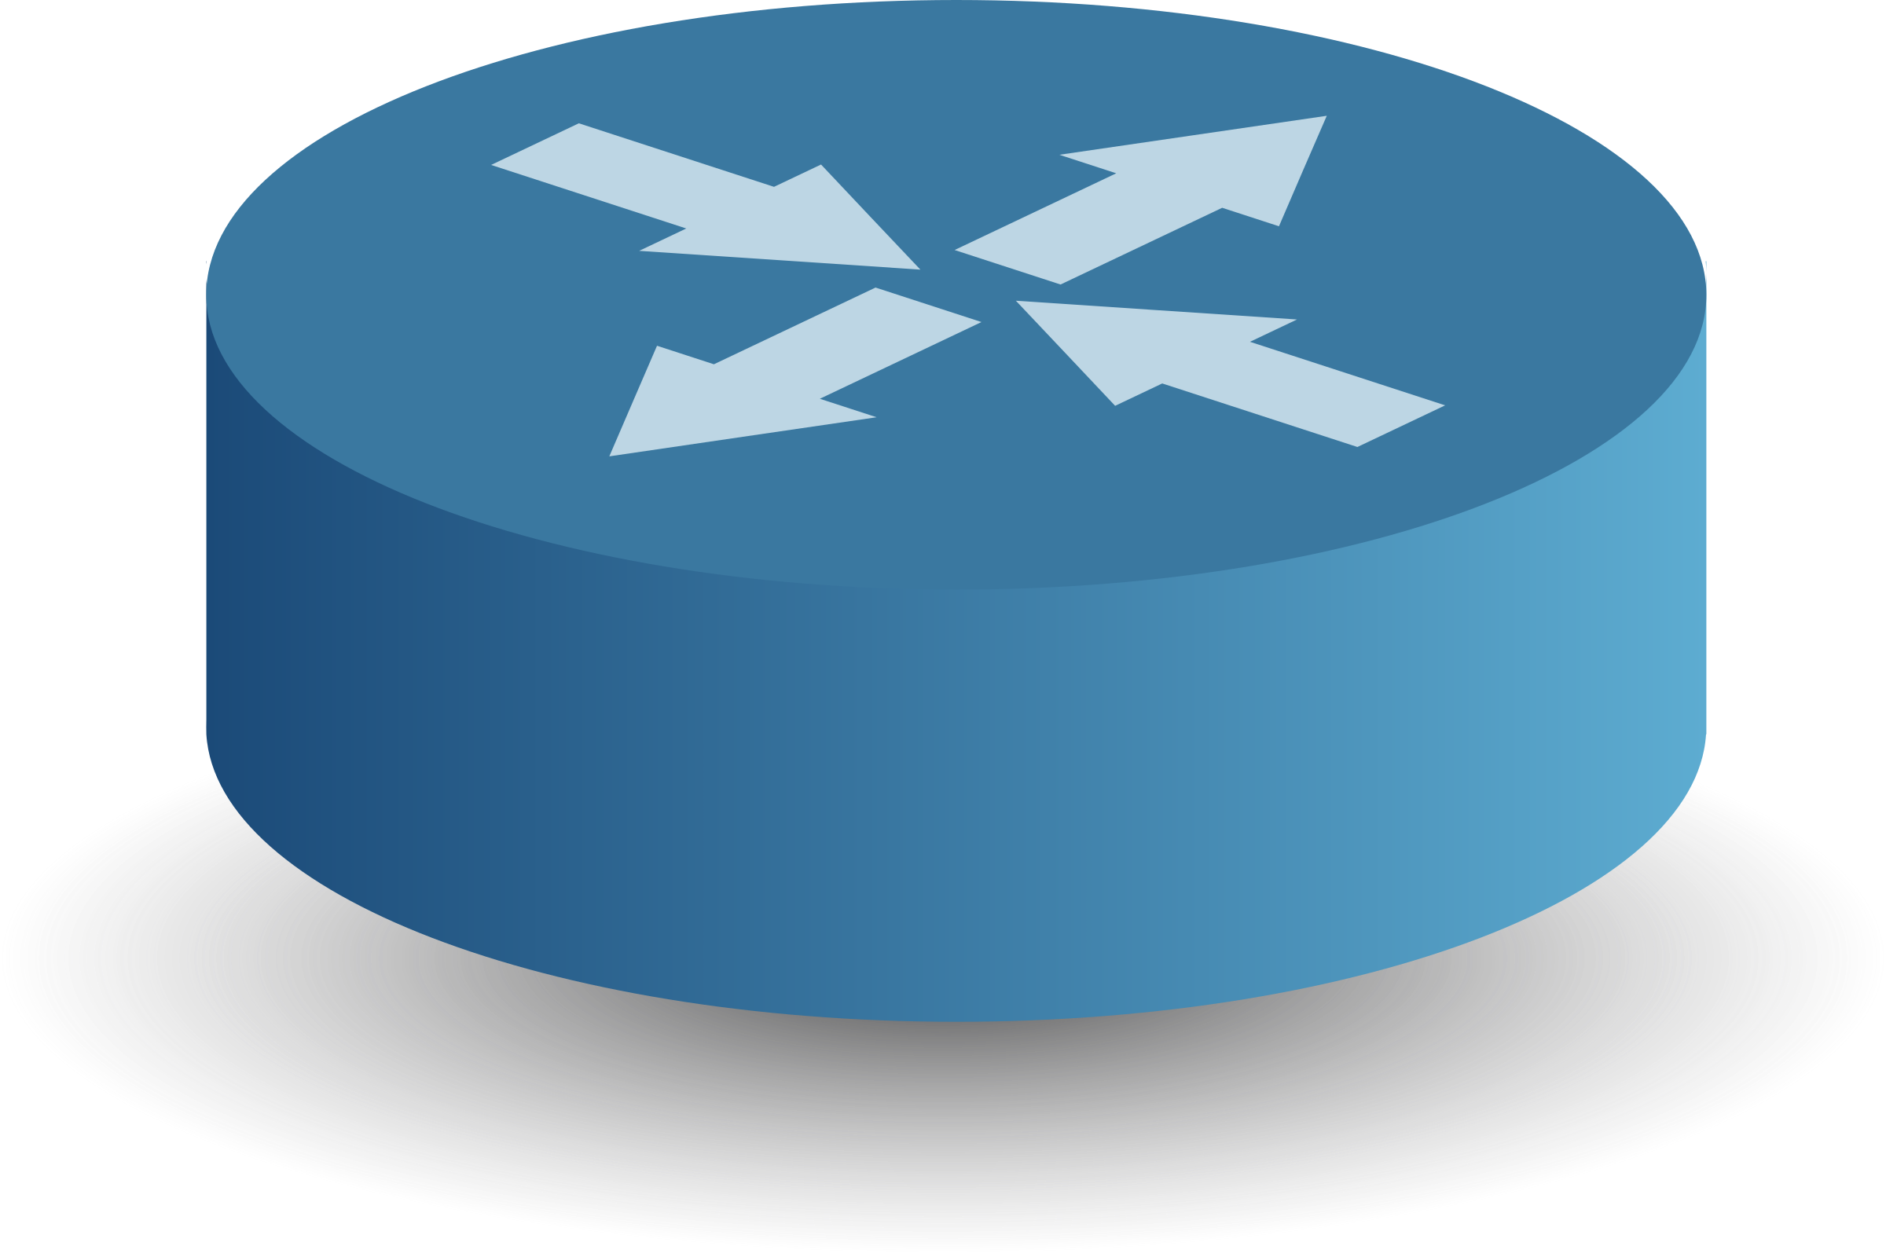
Azure high-level network architecture
Azure region
Azure region
Azure region
DC facilities in a metro area
DC facilities in a metro area
DC facilities in a metro area
……………………………….
All regions are connected to Microsoft’s global backbone
Azure WAN (global MS backbone)
Internet

Slide 10
Azure high-level network architecture
Azure region
Azure region
Azure region
DC facilities in a metro area
DC facilities in a metro area
DC facilities in a metro area
……………………………….
All regions are connected to Microsoft’s global backbone
Azure WAN (global MS backbone)
The Microsoft backbone interconnects all regions with each other and with the public internet
The Microsoft network peers with 2500+ ISP in 130+ PoPs
Internet

Slide 11
Azure high-level network architecture
Azure region
Azure region
Azure region
DC facilities in a metro area
DC facilities in a metro area
DC facilities in a metro area
……………………………….
All regions are connected to Microsoft’s global backbone
Azure WAN (global MS backbone)
The Microsoft backbone interconnects all regions with each other and with the public internet
The Microsoft network peers with 2500+ ISP in 130+ PoPs
Internet
Customers can use their existing internet connectivity to reach the Microsoft network and consume services in Microsoft datacenters

Slide 12
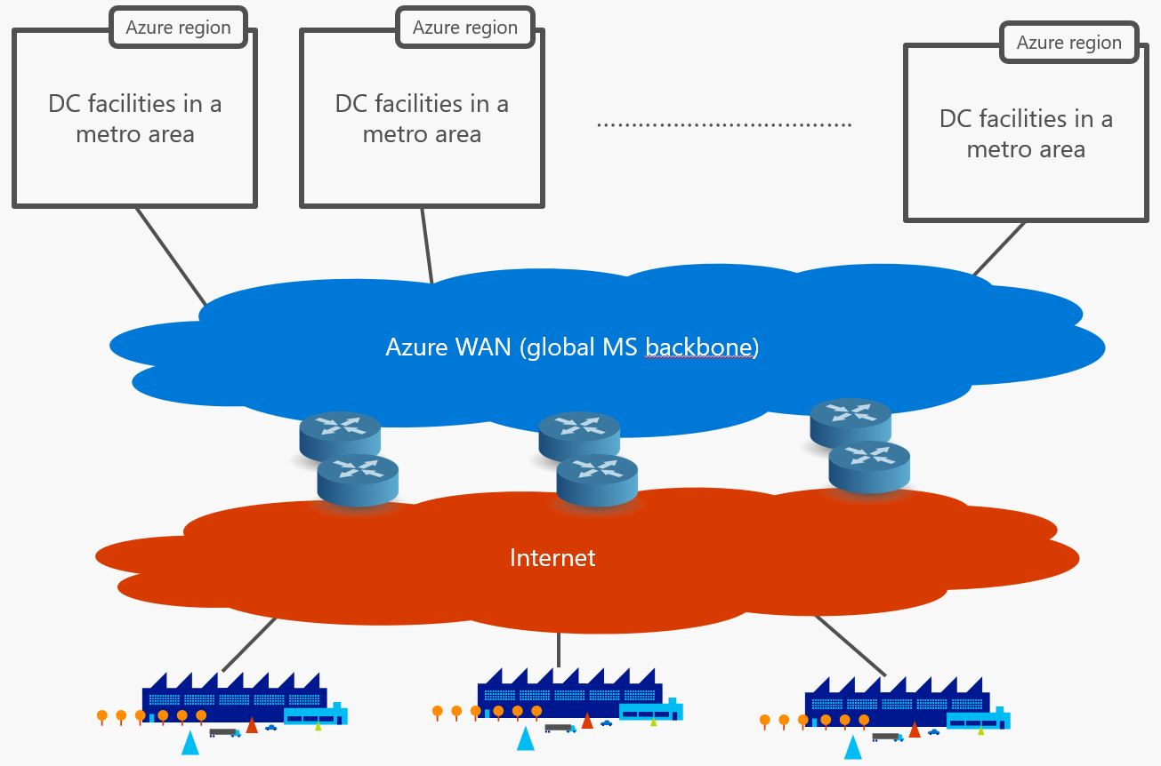
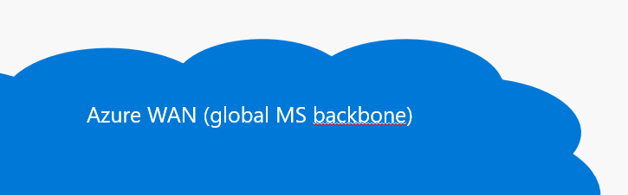
Network connectivity for Azure services Public vs. private services
Azure region

Slide 13
Network connectivity for Azure services Public vs. private services
Azure region
Public services are exposed to the internet over public IPs belonging to Microsoft
Azure SQL DB
Azure Storage
Most PaaS services
SQL DB
App Service
Internet-routable public IP assigned by the platform

Slide 14
Network connectivity for Azure services Public vs. private services
Azure region
Private services are deployed within Azure Virtual Networks, and are assigned private IP addresses taken from customer-controlled address space
Virtual Machines
“VNet injected” services
SQL DB
App Service
Azure VNet
Virtual machine
Virtual machine
Virtual machine
Isolated network with custom-defined address space (typically RFC1918)

Slide 15
Network connectivity for Azure services Internet access for Virtual Networks
Azure region
Every VNet provides internet access for VMs via a platform-managed gateway
SQL DB
App Service
Azure VNet
Virtual machine
Virtual machine
Virtual machine
Internet Gateway
NAT address
The gateway provides NAT for internet connections (DNAT for inbound, SNAT for outbound)

Slide 16
Network connectivity for Azure services VPN access for Virtual Networks
Azure region
A platform-managed VPN gateway can be deployed to establish IPSec tunnels to VNets over the internet
SQL DB
App Service
Azure VNet
Virtual machine
Virtual machine
Virtual machine
Internet Gateway
VPN
Gateway
Public IP address = remote tunnel endpoint to terminate IPSec tunnels

Slide 17
Azure high-level network architecture The big picture
Azure region
Azure region
SQL DB
App Service
Azure VNet
SQL DB
App Service
Azure VNet
Virtual machine
……………………………….
Virtual machine
Virtual machine
Virtual machine
Virtual machine
Virtual machine
Internet Gateway
VPN
Gateway
Internet Gateway
VPN
Gateway
Azure WAN (global MS backbone)
Internet

Slide 18
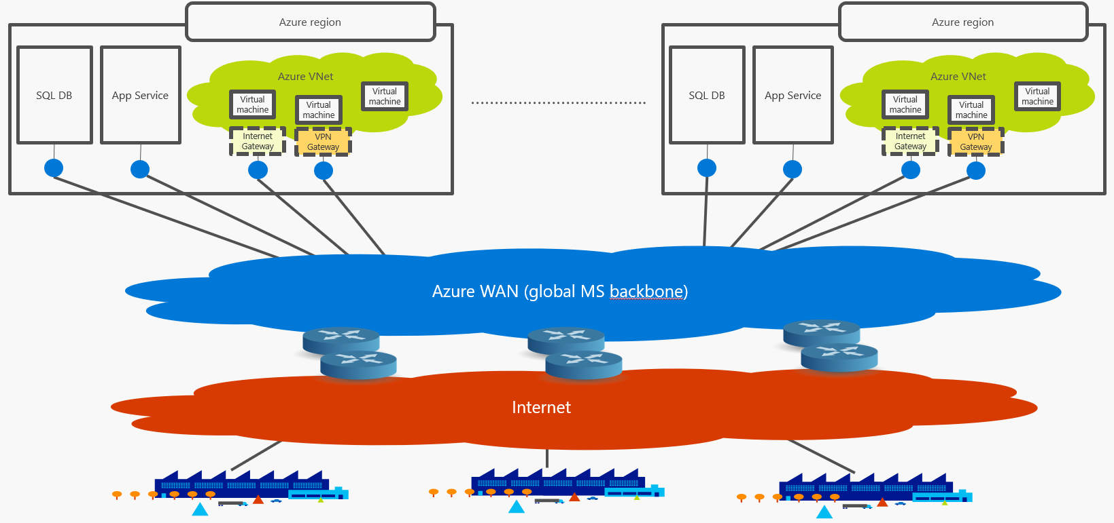
Azure high-level network architecture In review
Key takeaways
Azure resources run in datacenter clusters (regions) available in 54 metros worldwide
A global network privately owned by Microsoft connects all regions with each other and with the public internet
Azure public services are exposed over public IP addresses belonging to the Microsoft network and are reachable from the internet
Azure customers can build private network and connect them their corporate networks over internet-based VPNs

Slide 19
Logical layered isolation
…is inherent in Azure design
Notes:
Isolation is key to protecting Azure deployments. There are many elements that create a layered approach to securing your data and applications in Azure. As this picture shows Internet access, we will look at how your deployment can be secured against such exposure. What is worth noting is the sophisticated Distributed Denial of Service protection based on machine learning and Microsoft’s global view of real-time security threats.

Slide 20




Protecting your application
DDOS Protection
Adaptive tuning based on platform insights and application traffic patterns
Any injected workload in the VNet is automatically protected
From the Internet
Azure DDoS Protection
Attacker
Azure Backbone
VNet
Within the
VNet
Within Azure
Advanced protection for your virtual networks
Automatic mitigation for 60+ network layer attacks
Notes:
Azure DDoS Protection Standard is a new offering which provides additional DDoS mitigation capabilities and is automatically tuned to protect your specific Azure resources. Protection is simple to enable on any new or existing Virtual Network and requires no application or resource changes. Standard utilizes dedicated monitoring and machine learning to configure DDoS protection policies tuned to your Virtual Network. This additional protection is achieved by profiling your application’s normal traffic patterns, intelligently detecting malicious traffic and mitigating attacks as soon as they are detected. DDoS Protection Standard provides attack telemetry views through Azure Monitor, enabling alerting when your application is under attack. Integrated Layer 7 application protection can be provided by Application Gateway WAF.

Slide 21

Protecting your application
Web Application Firewall
Site 1
Protect your app against prevalent X- Site Scripting and SQL Injection attacks
Blocks threats based on Top 10 OWASP signatures
Integrated with Azure Security Center
Real-time logging with Azure Monitor
Platform managed, scalable and highly available
From the Internet
App Gateway
Valid request
XSS attack
Within the
VNet
WAF
Valid request
Site 2
Within Azure
Valid request
SQL injection
L7 LB
Notes:
Open WEB Application Security Project
App Gateway provides both WAF and L7 LB features

Slide 22
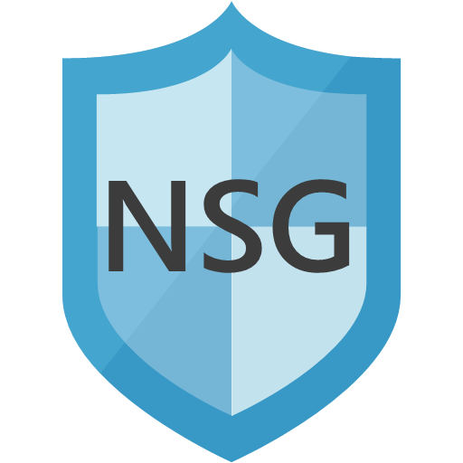
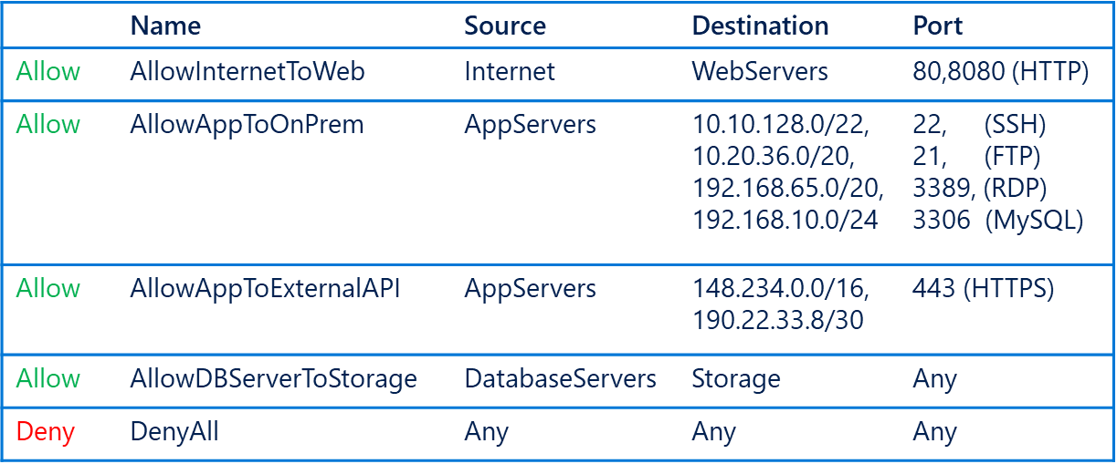
Protecting your application
Simplified Security Group Management
Network Security Groups (NSG)​
IP based network ACL​
Attach: Subnet and NICs​
Service Tags​
Named monikers for Azure service IPs​
SQL, Storage, Traffic Manager supported​​
Application Security Groups (ASG)​
Named monikers for custom grouping of VMs​
Natural expression of application security
From the Internet
WebServers
Within the
VNet
AppServers
DatabaseServers
Within Azure

Slide 23



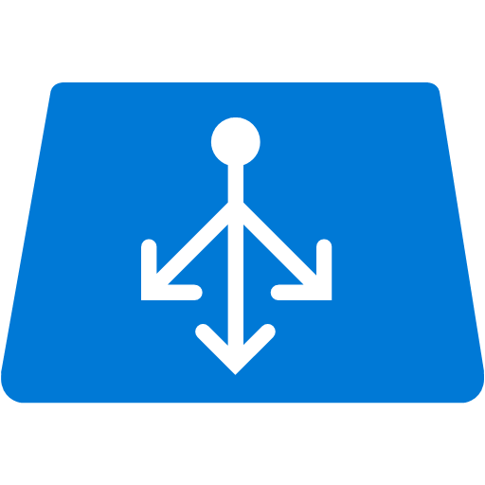


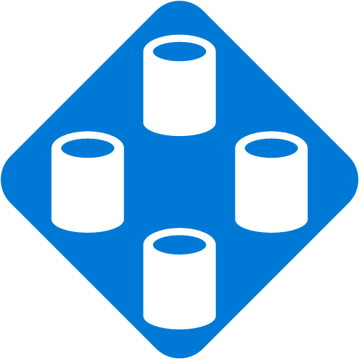

Protecting your application
Securing PaaS Services
Internet
Internet
From the Internet
VNet Service Endpoint
Within the
VNet
Within Azure
PaaS services
Compute - VNet

Slide 24
Expressroute fundamentals

Slide 25
Why Expressroute? The need for enterprise-grade connectivity
Enterprise-grade network; no congestion due to proactive bandwidth provisioning + aggressive traffic engineering (SWAN)
Private datacenter network, high bandwidth (10, 40, 100 Gb/s)

Slide 26

Why Expressroute? The need for enterprise-grade connectivity
Enterprise-grade network; no congestion due to proactive bandwidth provisioning + aggressive traffic engineering (SWAN)
Best effort service (unpredictable performance)
Private datacenter network, high bandwidth (10, 40, 100 Gb/s)
This Photo by Unknown Author is licensed under CC BY-SA

Slide 27
What is Expressroute? Private connections to the Microsoft backbone
Expressroute peering location
Carrier Neutral Facility
Microsoft
Microsoft Enterprise Edge (MSEE) routers

Slide 28
What is Expressroute? Private connections to the Microsoft backbone
Carrier Neutral Facility
Microsoft
Carrier #1
Carrier #2
Carrier #3

Slide 29
What is Expressroute? Private connections to the Microsoft backbone
Carrier Neutral Facility
Microsoft
Carrier #1
Carrier #2
Carrier #3

Slide 30
What is Expressroute? Private connections to the Microsoft backbone
Carrier Neutral Facility
Microsoft
Carrier #1
Carrier #2
Carrier #3
Customer A

Slide 31
What is Expressroute? Private connections to the Microsoft backbone
Carrier Neutral Facility
Microsoft
Carrier #1
Carrier #2
Carrier #3
Customer C
Customer A
Customer B

Slide 32
What is Expressroute? Private connections to the Microsoft backbone
Carrier Neutral Facility
Microsoft
Carrier #1
Carrier #2
Carrier #3
Customer C
dedicated bandwidth & predictable latency
Customer A
Customer B

Slide 33
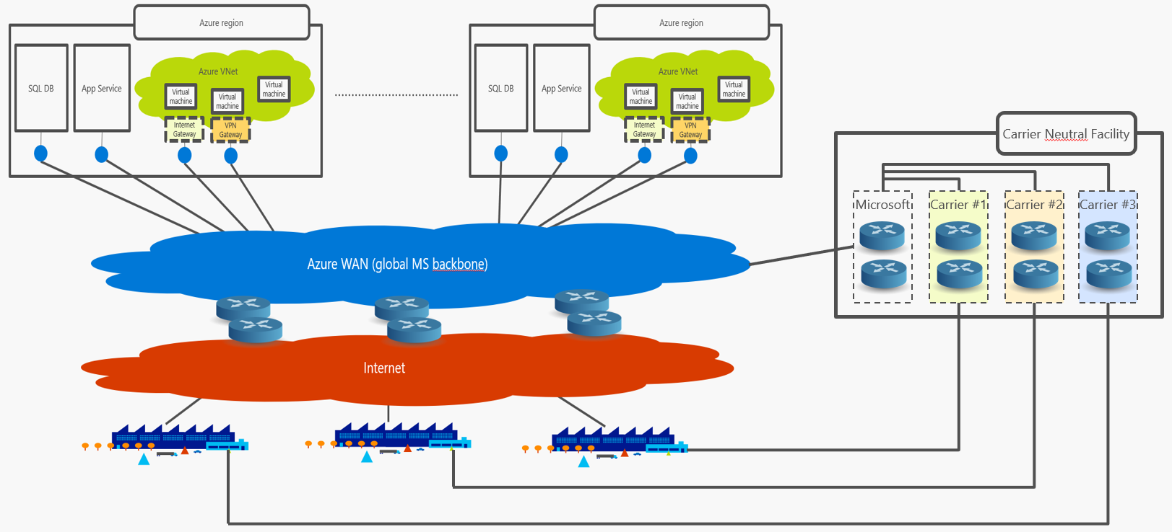
Why Expressroute? Value proposition & key benefits
Expressroute allows customers to peer with the Microsoft network over dedicated links, bypassing the public internet
Customers get dedicated bandwidth on Microsoft routers
Microsoft proactively manages capacity to ensure that bandwidth allocated to customers is always available => no congestion
Without congestion, latency and throughput are consistent over time and predictable
Predictable latency is one of the key enablers for cloud adoption

Slide 34
Expressroute key facts #1: Peering locations are NOT Azure datacenters
Microsoft-managed DCs, hosting the Azure fabric and Azure resources deployed on top of it
Facility owned & managed by third party
Microsoft is a customer, buys hosting space to deploy its ER routers

Slide 35
Expressroute key facts #2: An ER circuit is a connection the Microsoft network, not to a specific Azure region
Carrier Neutral Facility
Microsoft
Carrier #1
Carrier #2
Carrier #3
ER connects Customer B’s premises to the Microsoft network
Customer B

Slide 36
Expressroute key facts #3: A single ER circuit provides access to resources in multiple Azure regions
Carrier Neutral Facility
Microsoft
Carrier #1
Carrier #2
Carrier #3
One ER circuit
Customer B

Slide 37


Expressroute in South Africa Regions and peering locations
(other regions)
South Africa West
South Africa North
SQL DB
App Service
Azure VNet
SQL DB
App Service
Azure VNet
Virtual machine
Virtual machine
Virtual machine
Virtual machine
Virtual machine
Virtual machine
Internet Gateway
VPN
Gateway
Internet Gateway
VPN
Gateway
TERACO Rondebosch
TERACO Isando
Azure WAN (global MS backbone)
Microsoft
Carrier #1
Carrier #2
Carrier #3
Microsoft
Carrier #1
Carrier #2
Carrier #3
Internet

Slide 38
Expressroute in South Africa Typical disaster-resilient implementation (two ER circuits)
South Africa West
South Africa North
SQL DB
App Service
Azure VNet
SQL DB
App Service
Azure VNet
Virtual machine
Virtual machine
Virtual machine
Virtual machine
Virtual machine
Virtual machine
Internet Gateway
VPN
Gateway
Internet Gateway
VPN
Gateway
TERACO Rondebosch
TERACO Isando
Azure WAN (global MS backbone)
Microsoft
Carrier #1
Carrier #2
Carrier #3
Microsoft
Carrier #1
Carrier #2
Carrier #3
Internet
ER circuit #1
ER circuit #1

Slide 39
Expressroute in South Africa Typical disaster-resilient implementation (two ER circuits)
South Africa West
South Africa North
SQL DB
App Service
Azure VNet
SQL DB
App Service
Azure VNet
Virtual machine
Virtual machine
Virtual machine
Virtual machine
Virtual machine
Virtual machine
Internet Gateway
VPN
Gateway
Internet Gateway
VPN
Gateway
TERACO Rondebosch
TERACO Isando
Azure WAN (global MS backbone)
Microsoft
Carrier #1
Carrier #2
Carrier #3
Microsoft
Carrier #1
Carrier #2
Carrier #3
Internet
ER circuit #2 (carrier can be different than ER circuit #1)
ER circuit #1
ER circuit #1

Slide 40
Thank you
Matthew Levy
https://mattchatt.co.za
@skrods
https://www.linkedin.com/in/matthew-levy-170bbb21/

